Slide 1
Health Tracker Application
A Simple Tool for Tracking Weight, BMI, Exercise, and Hydration
Based on Python
Roudra Mondal (CST-3B)

Slide 2
Table of content
Introduction
Features
Technologies Used
Key Functions
Demonstrations
Future Enhancements
Conclusion

Slide 3
Introduction
Health tracking is essential for maintaining a balanced lifestyle.
This project provides an easy-to-use app for logging weight, BMI, exercise, and water intake.
Data is stored and can be reviewed over time to help users monitor progress.

Slide 4
Features
Weight & BMI Logging: Enter weight and height; BMI is automatically calculated.
Exercise Logging: Record workout type, duration, and calories burned.
Water Intake Logging: Track daily water consumption.
Data Storage & Review: Logs are saved in “Show logs” and can be viewed later.

Slide 5
Technologies Used
Python (Main Programming Language)
Tkinter (GUI for the user interface)
JSON (For storing user data)
Datetime Module (For timestamping logs)

Slide 6
Key Functions
log_weight() ---- Logs weight, height, BMI, and timestamp.
log_exercise() ---- Stores exercise type, duration and calories burned
log_water_intake() ---- Saves water intake logs.
show_logs() ---- Displays recorded data in a user friendly format

Slide 7
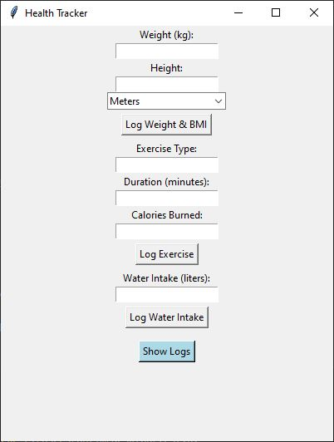
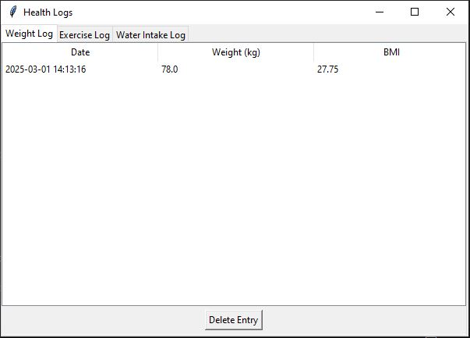
Demonstration
Screenshots of the main menu and the logs

Slide 8
Future Enhancements
Data Visualization: Graphs & charts for better insights.
User Profiles: Personal accounts for multiple users.
Mobile Version: Convert to a mobile app.

Slide 9
Conclusion
This Health Tracker makes it easy for users to log and monitor their health.
Helps maintain consistency in fitness and hydration habits.
Future improvements will enhance functionality and user experience.

Slide 10
Any Question ?

Slide 11
Thank you

